Slide 1
CST8288 Object-Oriented Programming with Design Patterns
Object-orientated review 1

Slide 2
Variables
Data Type | Default Value (for fields)
byte | 0
short | 0
int | 0
long | 0L
float | 0.0f
double | 0.0d
char | '\u0000'
String (or any object) | null
boolean | false
Don’t assume default values, always initialize!

Slide 3
print and println
System.out.println( "Welcome to Java!" );
int num = 5;
System.out.println("Your lucky number is" + num);
System.out.print(”Java is fun\n”);

Slide 4
printf
system.out.format and system.out.printf do the same thing
%c | character
%d | decimal (integer) number (base 10)
%e | exponential floating-point number
%f | floating-point number
%i | integer (base 10)
%o | octal number (base 8)
%s | a string of characters
%u | unsigned decimal (integer) number
%x | number in hexadecimal (base 16)
%% | print a percent sign
\% | print a percent sign

Slide 5
formatting
%3d right justify
%-3d left justify
%3.2f right justify with 2 decimal places
https://thejavacheatsheet.wordpress.com/2015/04/11/printf/

Slide 6
Example
double pi = 3.14159265359;
System.out.printf("Pi is %.0f with no decimal places\n", pi);
System.out.printf("Pi is %.2f with two decimal places\n", pi);
System.out.println("left justify with 4 decimal places");
System.out.printf("%40.4f\n", pi);
System.out.println("right justify with 6 decimal places");
System.out.printf("%-40.6f\n", pi);
Pi is 3 with no decimal places
Pi is 3.14 with two decimal places
left justify with 4 decimal places 3.1416
right justify with 6 decimal places
3.141593

Slide 7
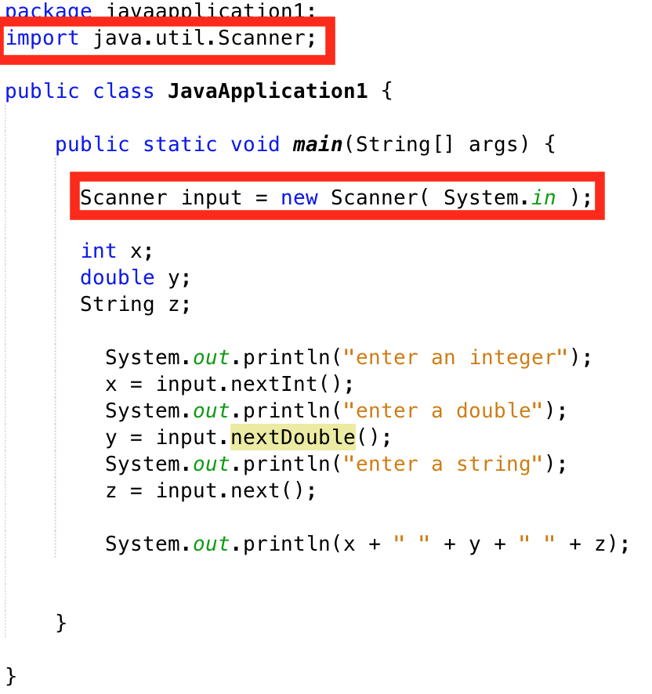
Input

Slide 8
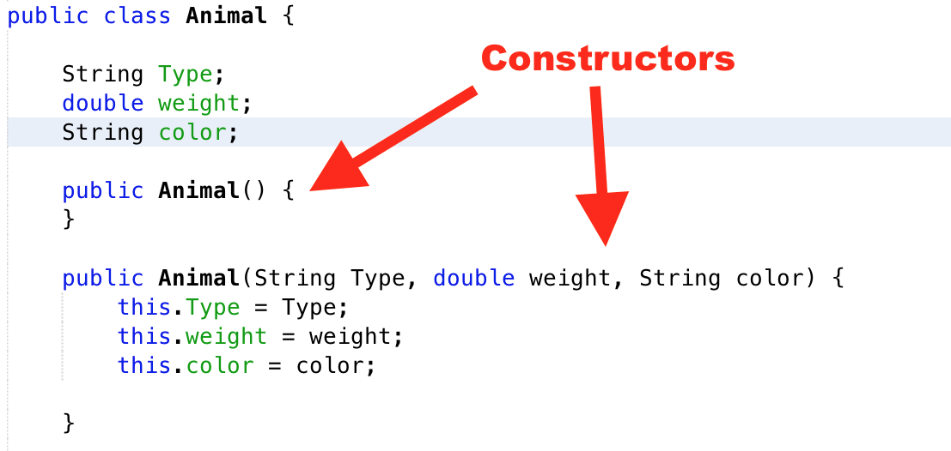
Class - Constructors

Slide 9
Encapsulation
Encapsulation is an Object Oriented Programming concept that binds together the data and functions that manipulate the data, and that keeps both safe from outside interference and misuse.

Slide 10
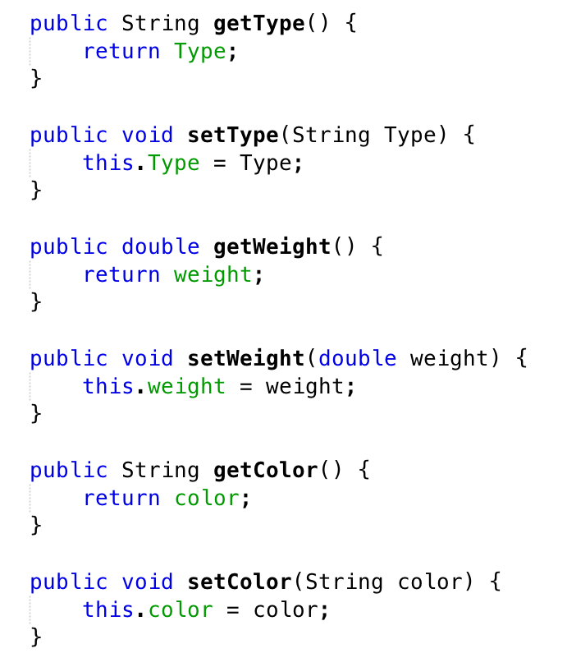
Setters and Getters
These methods should never contain any print statements or algorithms

Slide 11
ToString()
Very useful for debugging purposes

Slide 12
Creating Class Objects
public static void main(String[] args) {
Animal a = new Animal(); System.out.println(a.toString());
Animal b = new Animal("cat", 5.5, "black"); System.out.println(b.toString());
}
Animal{Type=null, weight=0.0, color=null}
Animal{Type=cat, weight=5.5, color=black}

Slide 13
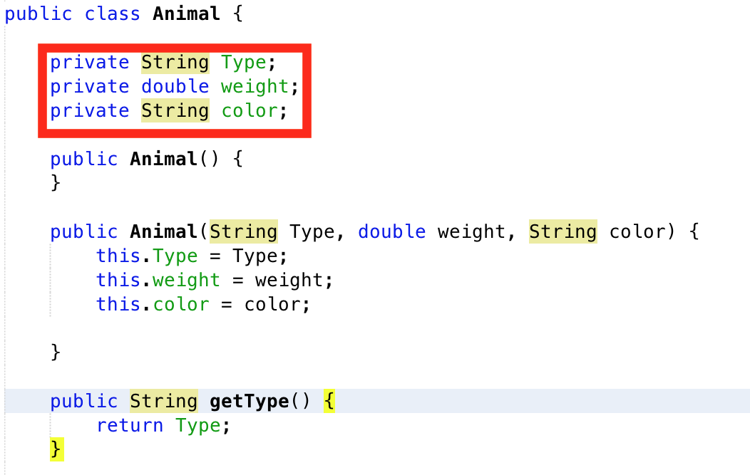
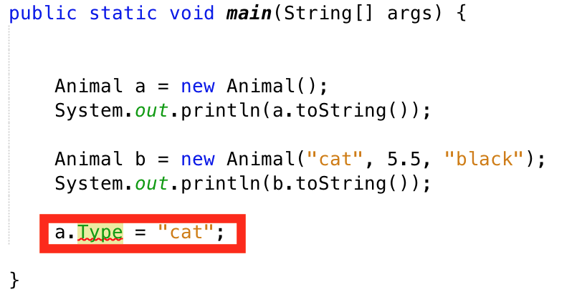
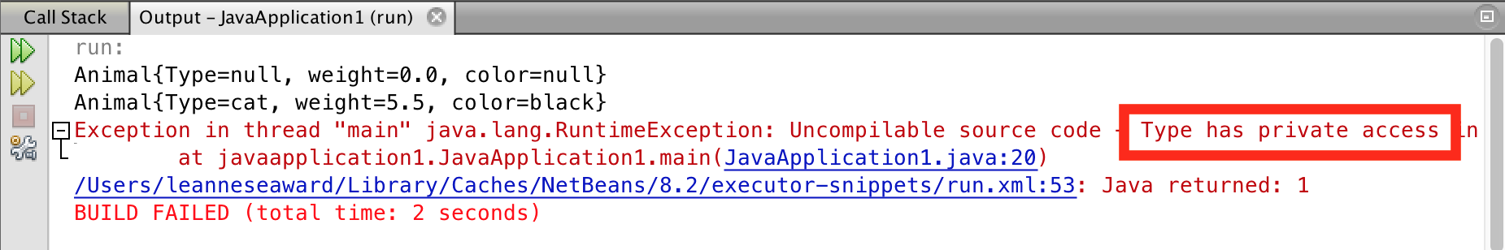
Private vs. Public Variables
Variables should be private and only accessed through the class methods

Slide 14
Information Hiding
Information hiding is implemented when a class has variables which cannot be accessed directly (private variables)
For example in a tax program you may have a variable tax rate which cannot be modified, this ensures that programmers using the class are using the right tax rate and not changing the tax rate to a rate of their choice.

Slide 15
Practice Exercise
Write a class called Student which has 3 fields – name, id number, and GPA
Create a constructor which takes only the Name and GPA and generates the id number randomly.
It should also make sure the GPA is between 0 and 4. If it is less than 0, then put 0, if it is more than 4 then put 4.
Create all setters and getters and a ToString method
In main as the user to enter the names and GPAs then create 2 students using the constructor
Use ToString to test the program

Slide 16
If Statement
int num = 5;
if (num < 7) {
System.out.println("less than 7");
}
else if (num > 4) { System.out.println("greater than 4");
}
What will print when both are true?
Less than 7
(first correct one)

Slide 17
For Loops
for (int i = 0; i < 100; i++){
System.out.println(i);
}
Prints 0 to 99

Slide 18
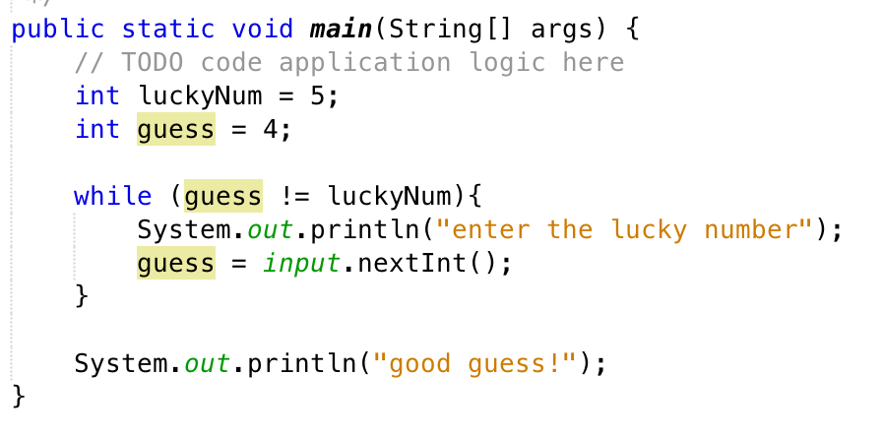
While Loop
Make sure the loop will start
Make sure the loop will end!

Slide 19
Arrays
Declaring Array
//Empty array of unspecified size
int[] anArray;
//Empty array of size 10
int anArray = new int[10];
//Full array of size 5 – size is implied
int anArray = {7, 5, 3, 1, 0]

Slide 20
Arrays, printing, modifying
Arrays can only be printed with a for loop
int [] a = {10, 20, 30, 40};
for (int i = 0; i < a.length; i++){
System.out.println(a[i]); }
You can also fill then with a for loop
for (int i = 0; i < a.length; i++){
a[i] = 7;
}

Slide 21
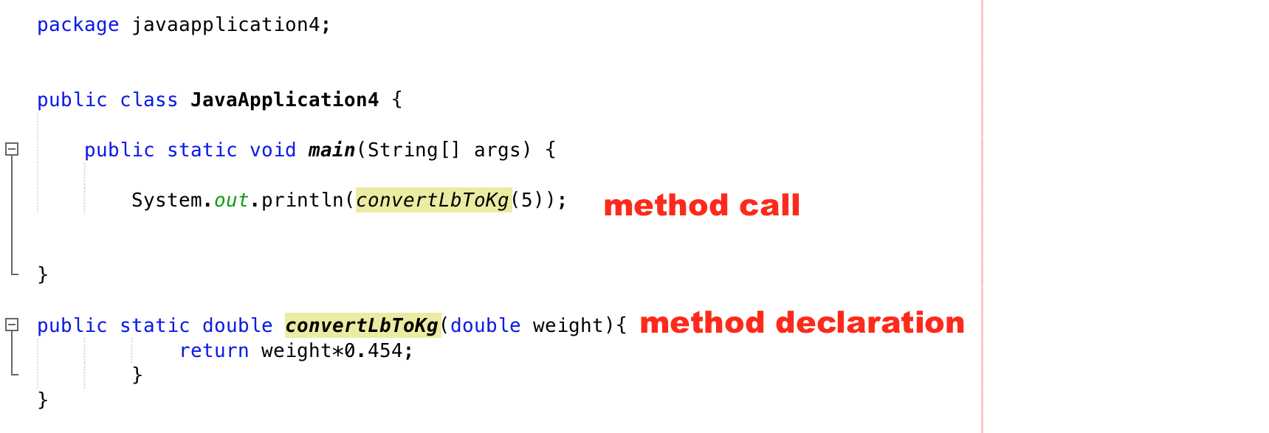
Methods

Slide 22
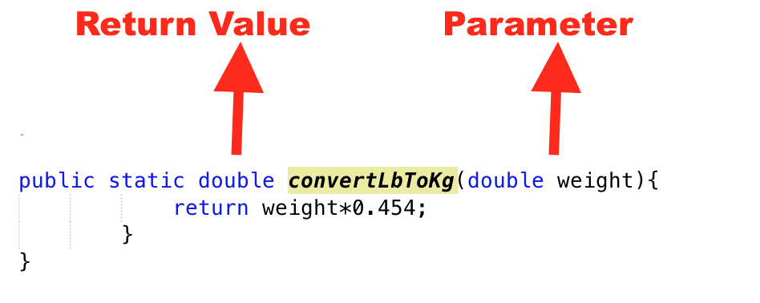
Method Declaration

Slide 23
Method Declaration
A return value and/or parameter is optional
public static void DoStuff(){
System.out.println("Hi!!!!!");
}

Slide 24
Inheritance
There are many types of Vehicles – Truck, Car, SUV, ATV etc.
They have some common characteristics – they all have engines, fuel economy ratings, 4 wheels and a color for example. Some have characteristics that do not apply to others. For example a car has a trunk and the other types do not.
If you were going to create an application to storev, you could make a class Vehicle and have the classes Car, Truck, SUV and ATV inherit from Vehicle.

Slide 25
Why use inheritance
Code re-use
The less code you have to write the less mistakes you will make
A change in all class such as a tax on price can be done in just the parent class
Polymorphism (more about that later)

Slide 26
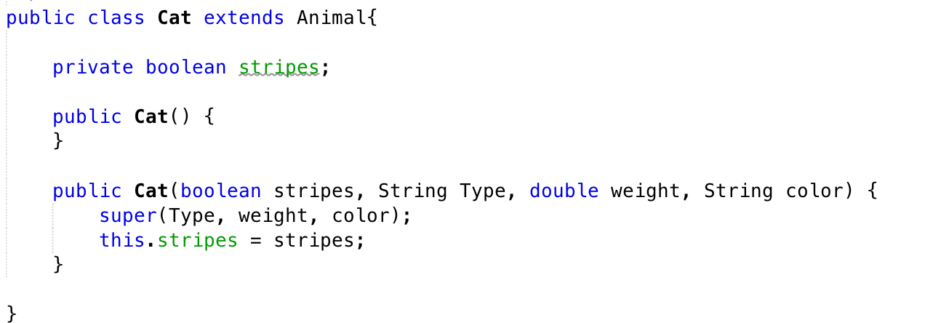
Inheritance Syntax

Slide 27
Polymorphism
Allows one to iterate over an array of objects of different sub-classes
Useful when there is a single method common to all
for (int i = 0; i < a.length; i+=){
a.commonMethod();
}

Slide 28
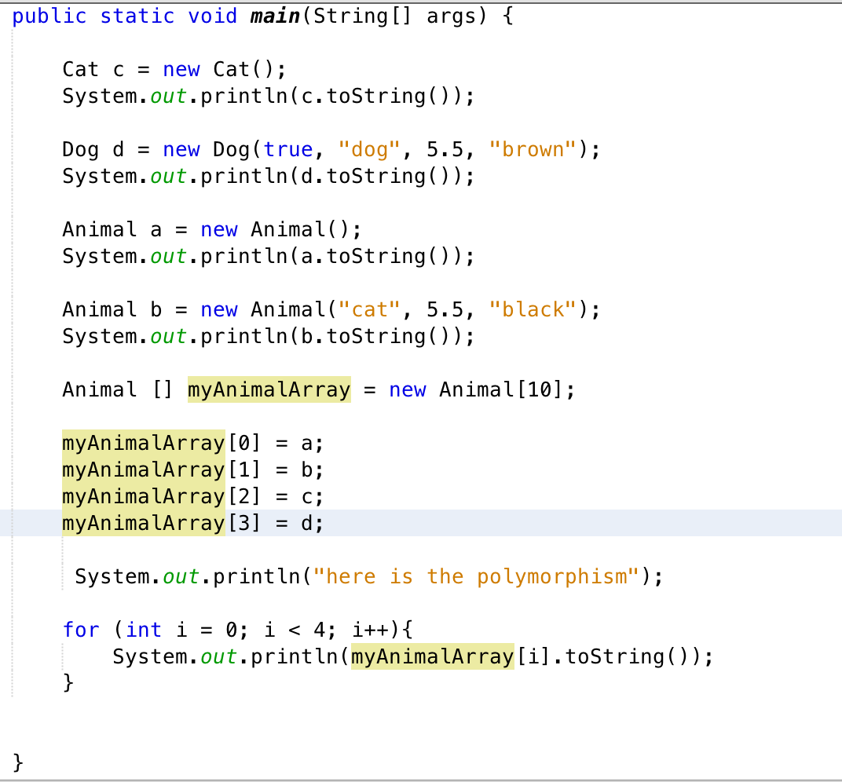
Example

Slide 29
Composite Classes
Composite classes have another class as a variable
Often used with arrays of objects

Slide 30
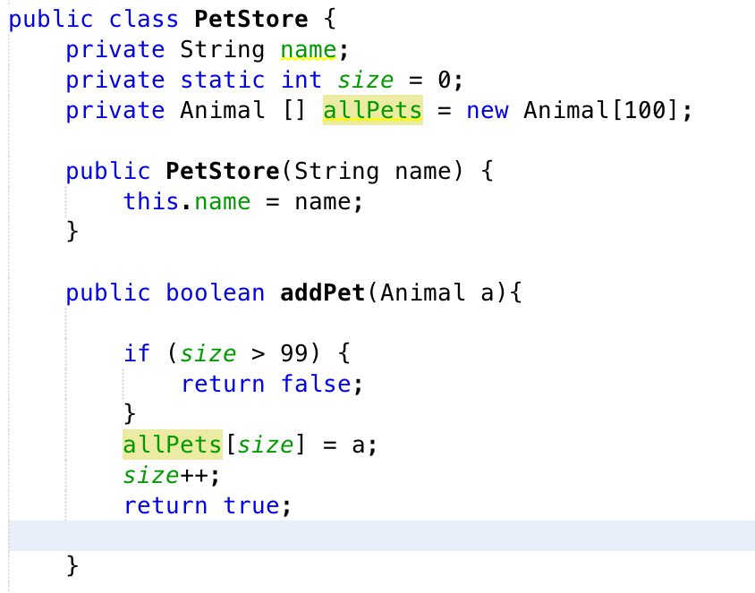

Slide 31
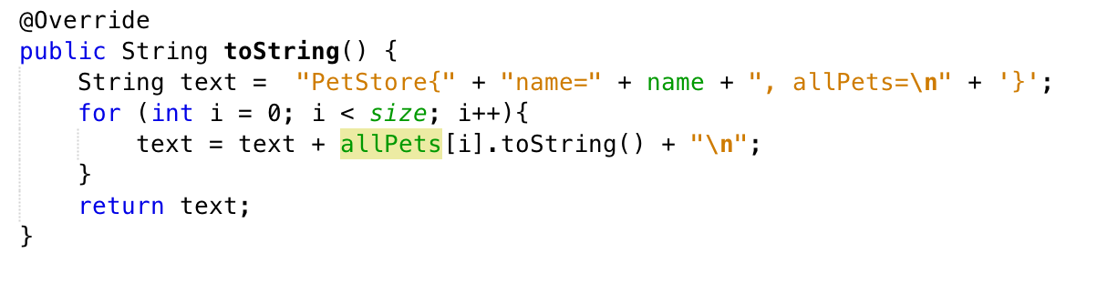
toString()

Slide 32
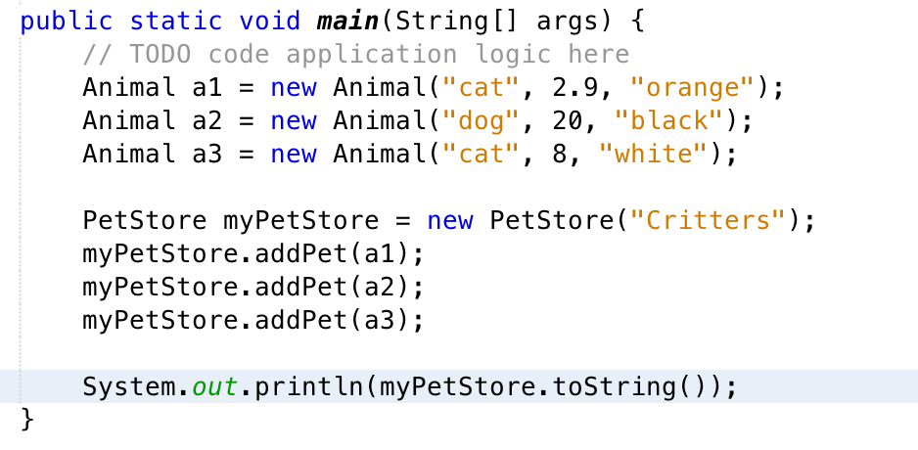
Main

Slide 33
Challenge
Take the code Pets from the website and add the method removePet(int i) where i the the index of the pet you will remove. Test it in main.

Slide 34
Abstract classes
Abstract classes are used when you want to implement one or more Abstract methods
You use an abstract method when you want a method which can be called on all members of super class and sub classes but calling the abstract method on a member of the super class does not make sense as the super class does not have the ability to implement the method

Slide 35
Examples
Super class ThreeDShapes
Sub Classes – Cone, Cylinder, Cube, Sphere
You wish to have the method getVolume() which is in each subclass and can be used when iterating through a polymorphic array of 3DShapes
Giving the volume of a 3DShape when you don’t know what it is makes no sense so make 3DShapes an abstract class with an abstract method getVolume()

Slide 36
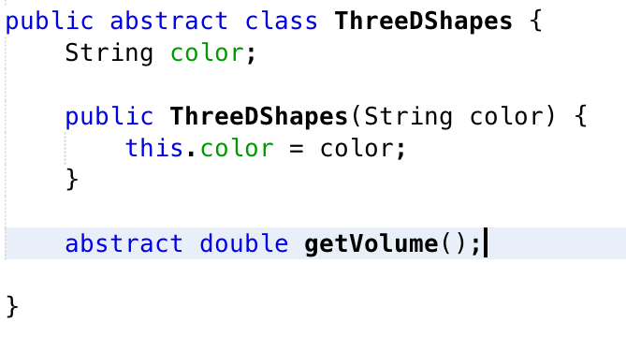

Slide 37
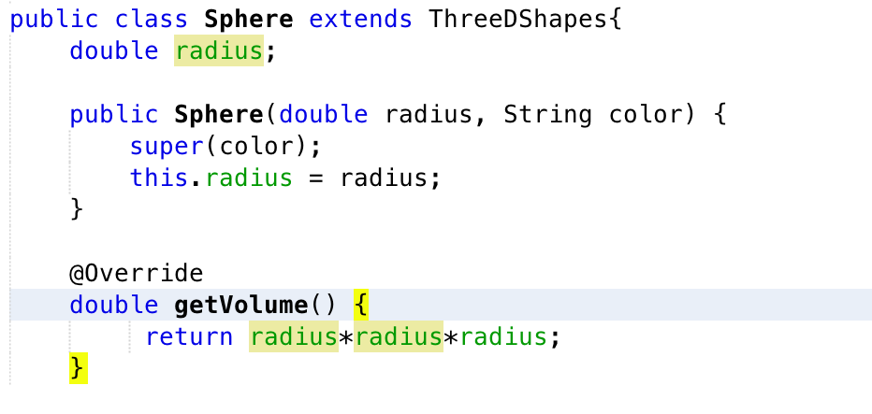

Slide 38
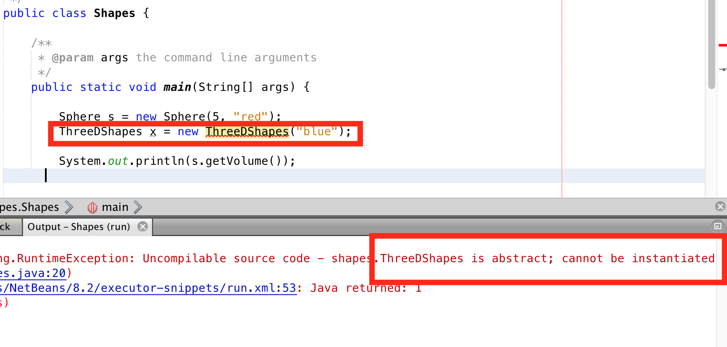

Slide 39
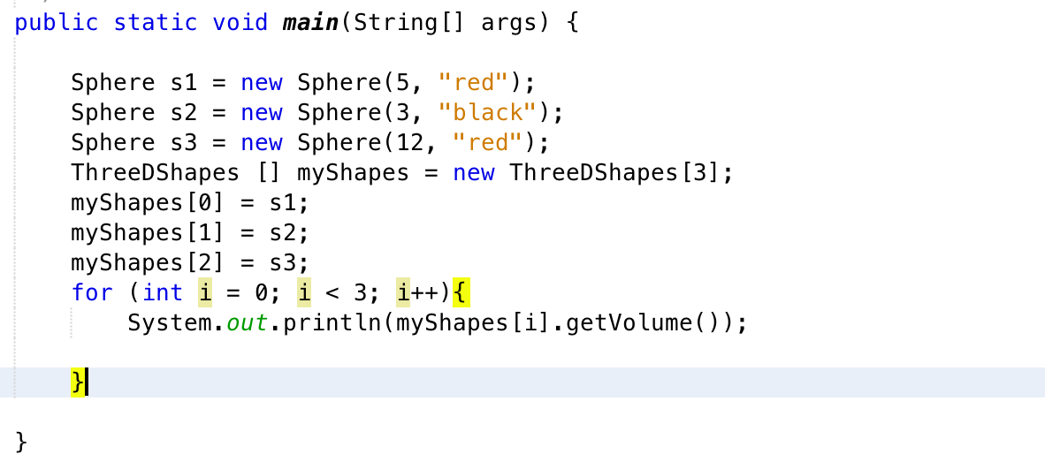
Can Still Do a Polymorphic Array

Slide 40
Classes – Data Members
Often an object has several variables associated with it
Employee – hoursPerWeek, hourlyRate, biWeeklyPay
Item – price, taxRate, finalPrice
Cube – length, volume

Slide 41
Can one be computed from the others?
Employee – hoursPerWeek, hourlyRate, biWeeklyPay
Item – price, taxRate, finalPrice
Cube – length, volume

Slide 42
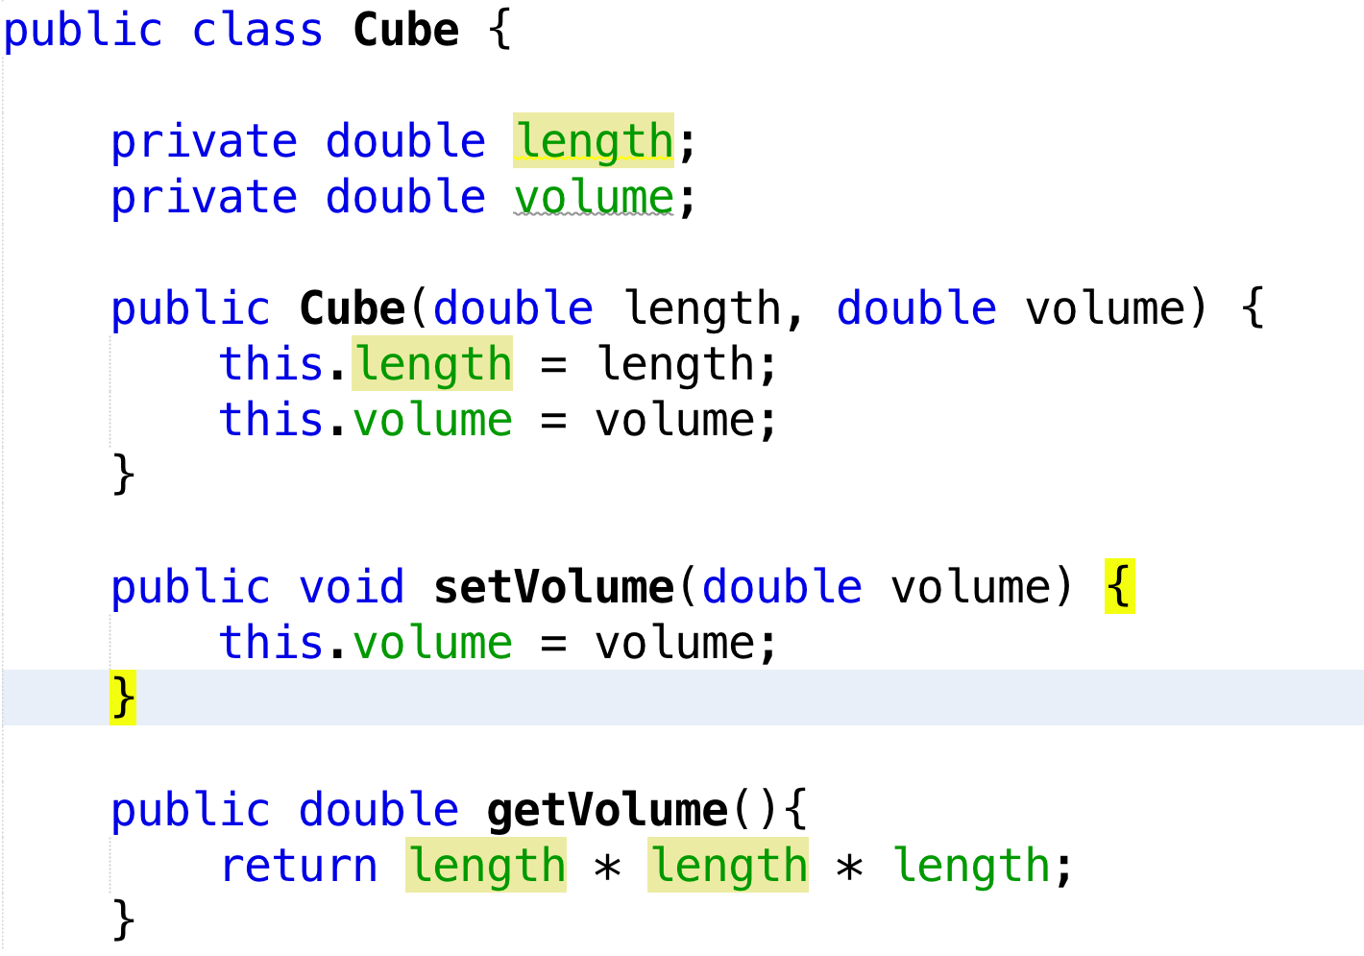
What is wrong with this code?

Slide 43
Class can be broken easily
Cube c = new Cube(2, 8);
c.setVolume(9);
The constructor itself can introduce errors as can the setter
A class is supposed to ensure that computations are correct no matter how it is used.

Slide 44
Keep data members independent
A computed variable should always be computed from the rest of the variables as needed
Reduces storage, decreases errors
Ensures the calculation is always used and the computed value is valid

Slide 45
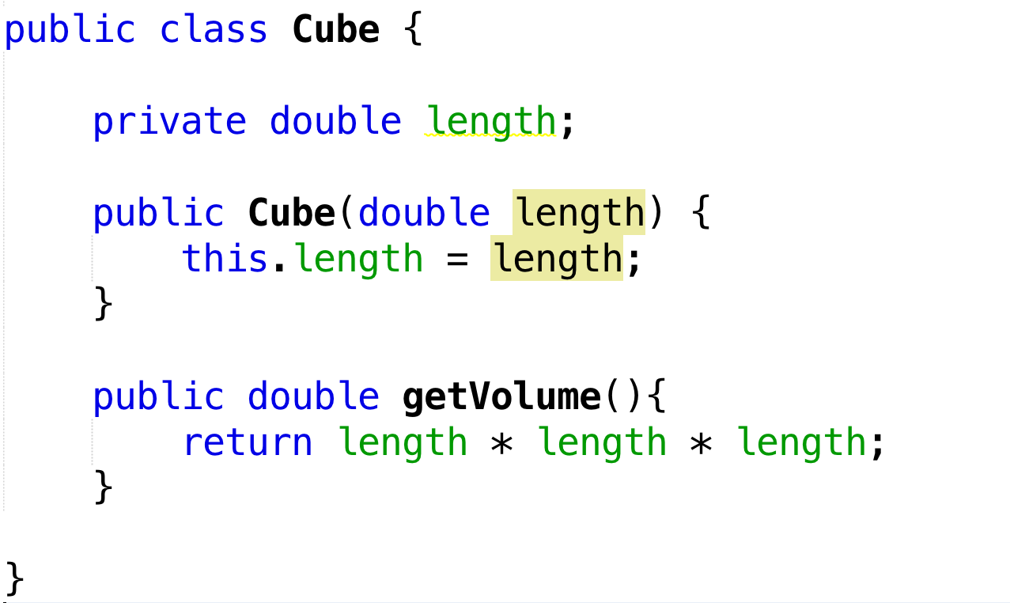
Better

Slide 46
UML
Unified Modelling Language
https://www.ibm.com/developerworks/rational/library/content/RationalEdge/sep04/bell/
http://www.cs.bsu.edu/~pvg/misc/uml/

Slide 47
UML Diagrams
Graphical way to show classes and the relationships between them
Round trip tools exist to convert UML into Java classes (Eclipse plug-in)
https://www.youtube.com/watch?v=buy35BArMaE
We will be doing this manually!

Slide 48
Tools
Pen and paper (the preferred method for midterms and final exams so know how to do it!)
Visio or Word
Tools such as Gliffy https://www.gliffy.com/

Slide 49
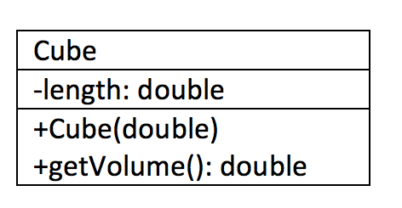
Writing a Single Class

Slide 50
Scope
- is private
+ is public
# protected
Cube has private data members and public methods

Slide 51
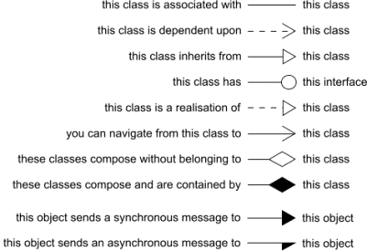
Arrows

Slide 52
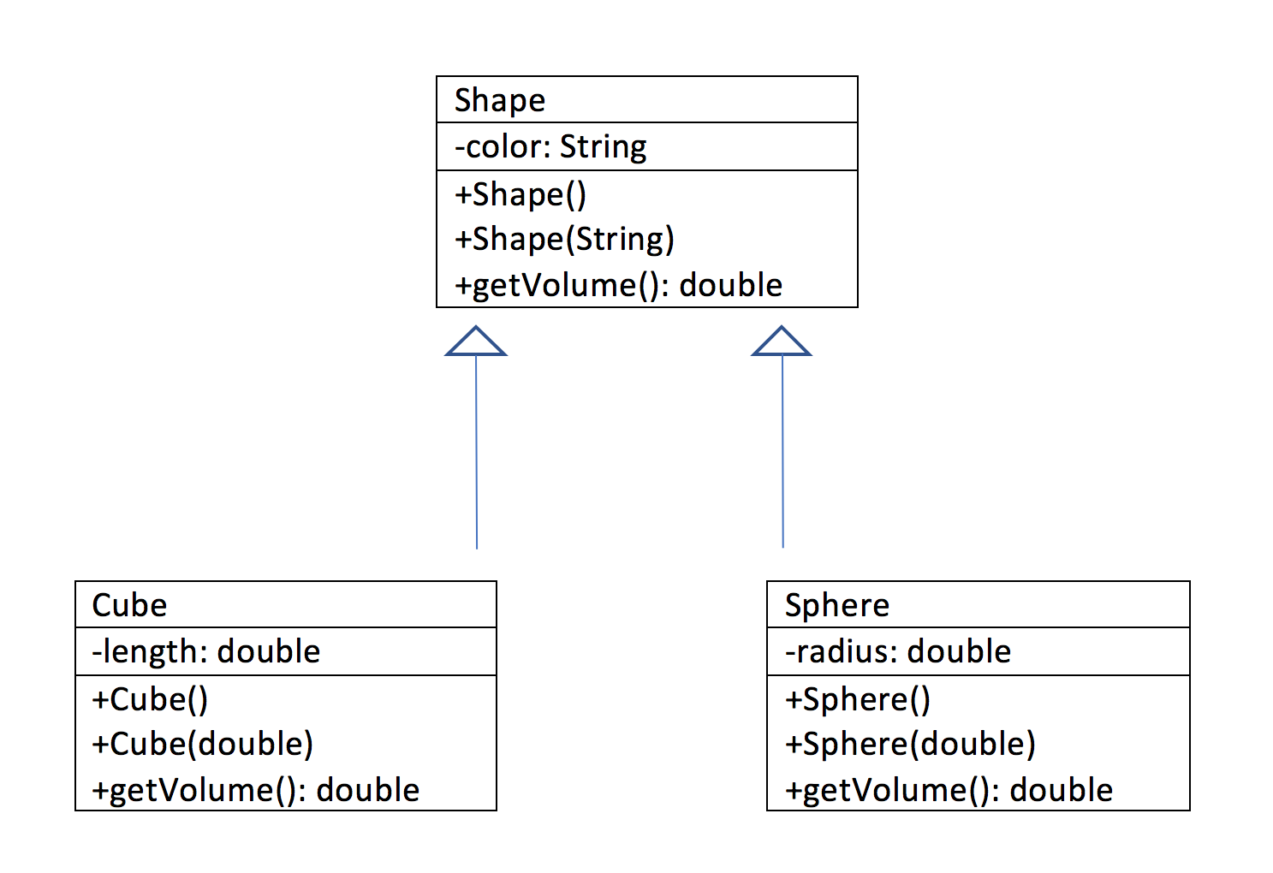
Inheritance
Cube is a Shape
Sphere is a Shape

Slide 53
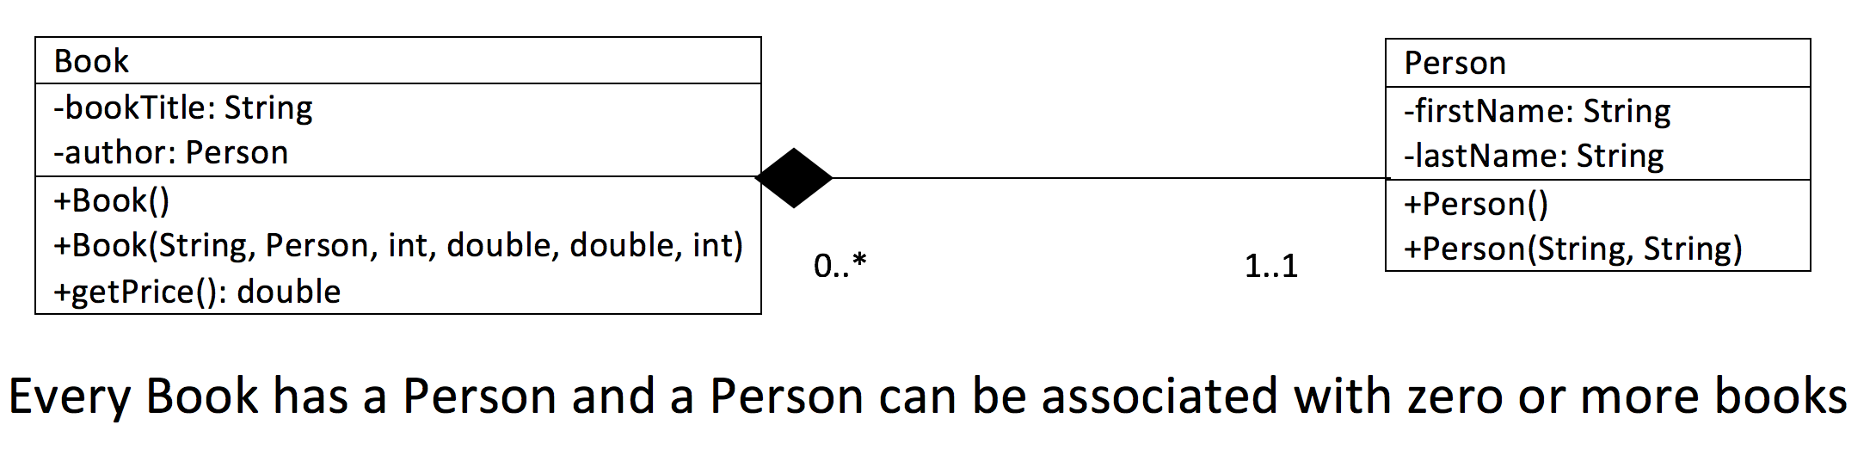
Composite Class

Slide 54
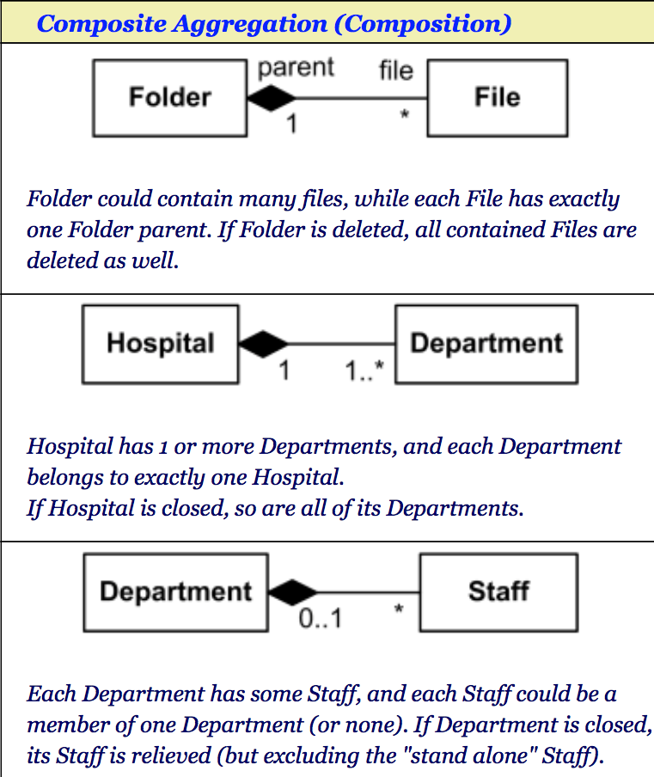

Slide 55
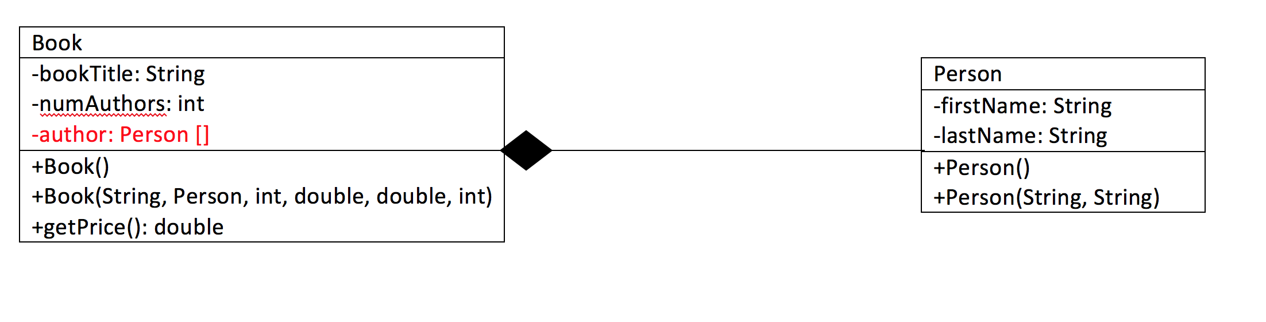
What is the relationship
0..*
0..*
Many to Many – A book has many authors and an author can have many books

Slide 56
Practice
Create a class called Person with variables firstName, lastName
Create a class called Inventory with the variables quantity, cost, markup (percentage – double), and inventoryId.
Create a default and parameterized constructor and a method called getPrice which returns the cost with the added markup. Create a protected method called getCost(). Also create a toString() method.

Slide 57
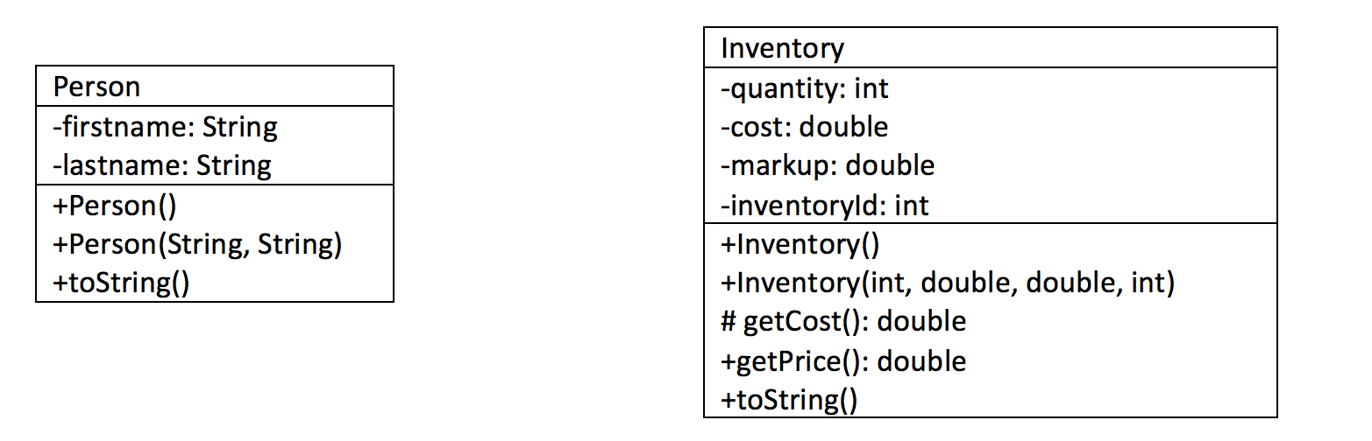

Slide 58
Practice Continued
Create a sub-class Book with variables author (type person) and bookTitle. The method price aldo adds a $1.00 stocking fee in addition to the markup. Add method toString().
Create a sub-class BlueRay with variables movieTitle, numActors, and actors (array of Person, max size 8), . The method price adds a 2% environmental fee in addition to the markup. Add method toString() which also loops through actors to display all actors.

Slide 59
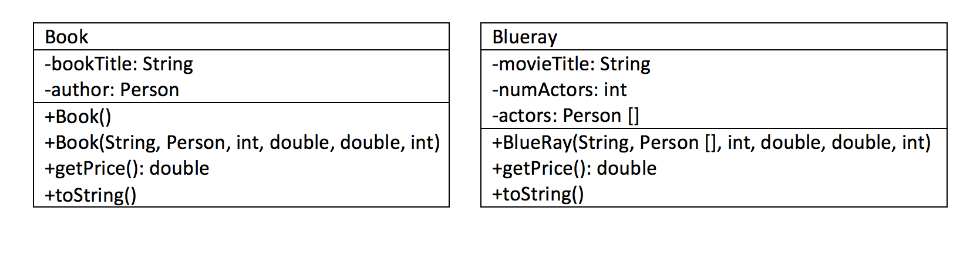

Slide 60
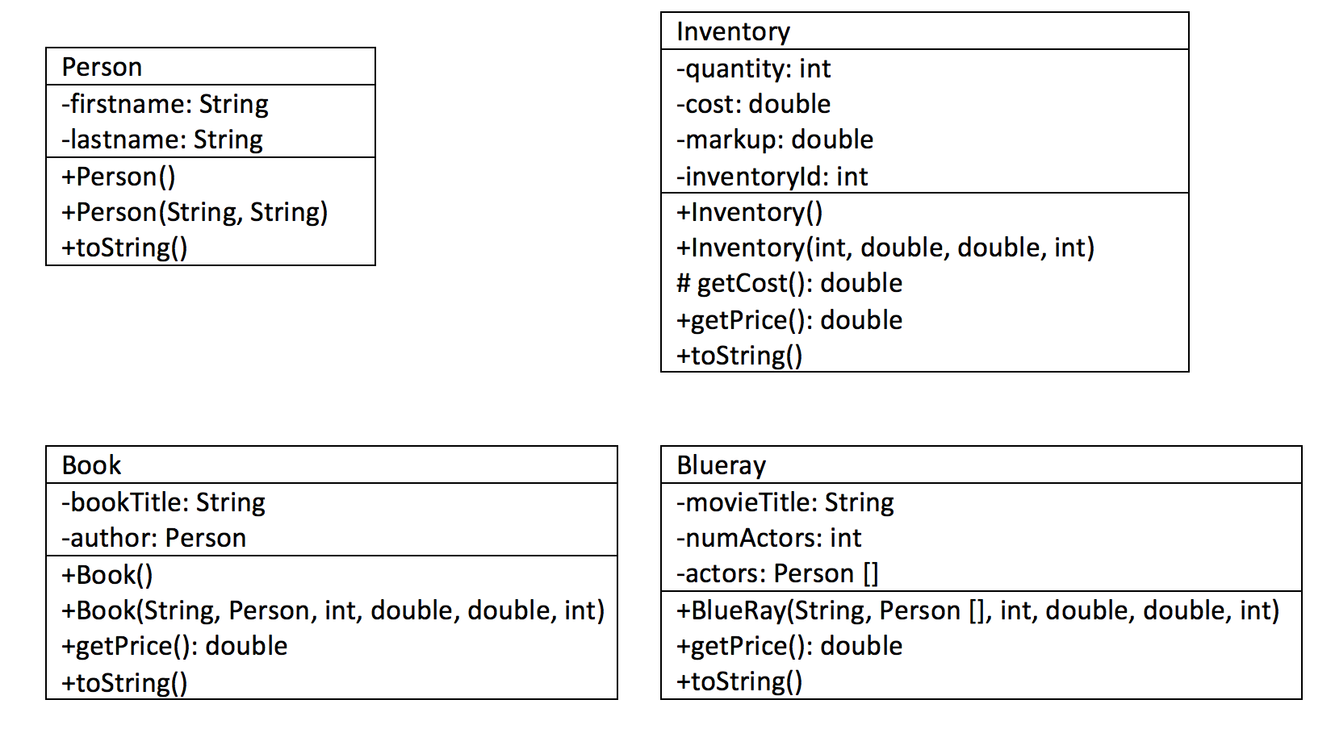
Draw the relationships

Slide 61
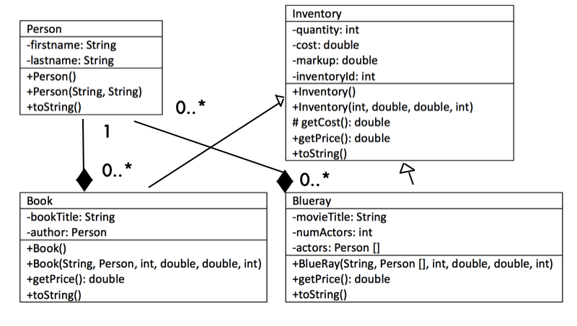

Slide 62
Write the code complete with documentation and Junit tests
In main create a polymorphic array of type Inventory, add 1 inventory item, 2 books and 2 movies (at least 2 actors each). Display each instance in the inventory array along with their price.

Slide 63
UML Links
http://www.cs.sjsu.edu/faculty/drobot/cs146/UMLDiagrams.htm
http://www.cs.unibo.it/~cianca/wwwpages/ids/esempi/uml-s.pdf
https://www.youtube.com/watch?v=3cmzqZzwNDM

Slide 64
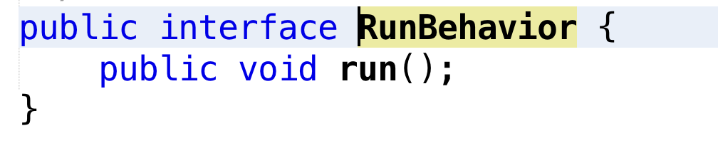
Interfaces
What is an interface?
An interface is a collection of methods – only the signatures or headers are given

Slide 65
Why use an interface?
Interfaces may be used when programmers are implementing code which must all interact the same way. The interface specifies the methods which must be implemented
Interfaces are better suited to situations in which your applications require many possibly unrelated object types to provide certain functionality.
Interfaces are more flexible than base classes because you can define a single implementation that can implement multiple interfaces.
Interfaces are better in situations in which you do not have to inherit implementation from a base class.

Slide 66
Change is a constant
All code will change
You should write your code expecting it to change
Interfaces help build software which can be changed more easily later

Slide 67
Examples
Interfaces are better suited to situations in which your applications require many possibly unrelated object types to provide certain functionality.
You are writing a video game with humans, aliens and zombies. These are all related so you wish to re-use code.
Humans walk normal and run fast
Zombies walk with a shuffle and cannot run
Aliens walk normal and cannot run

Slide 68
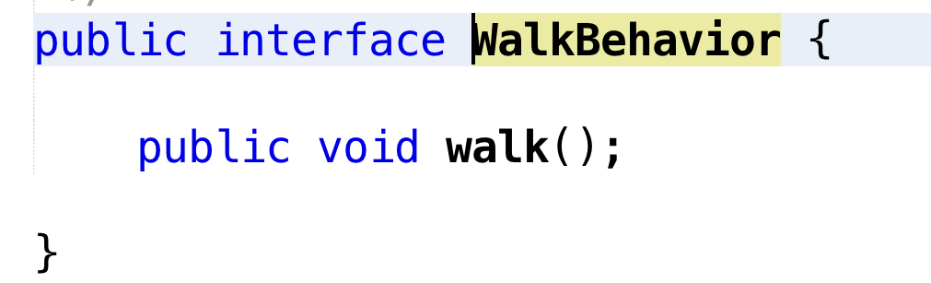
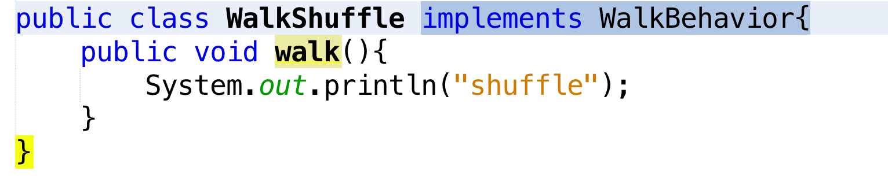
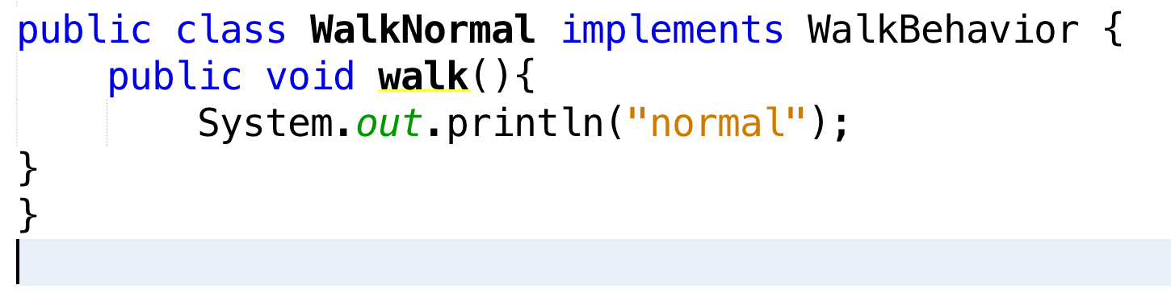
WalkBehavior

Slide 69
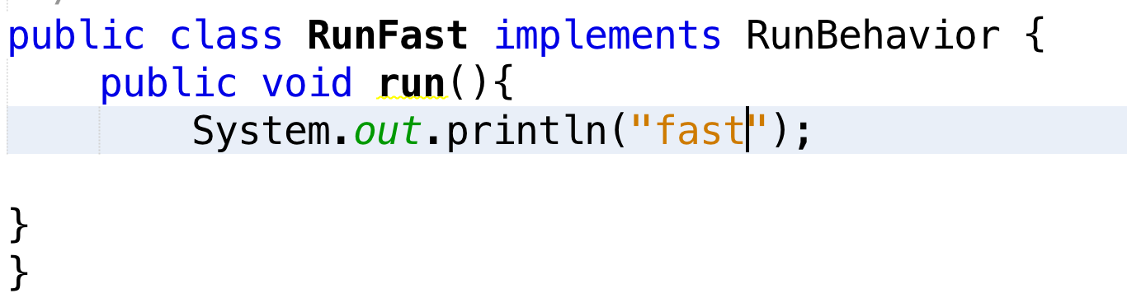
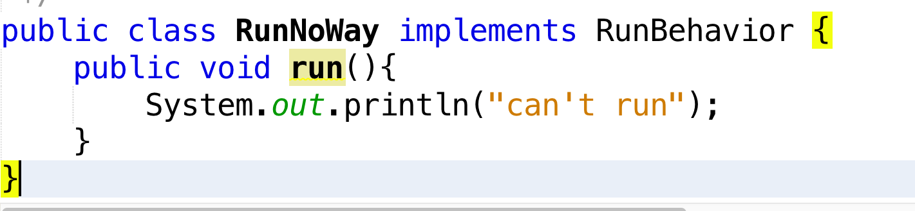
RunBehavior

Slide 70
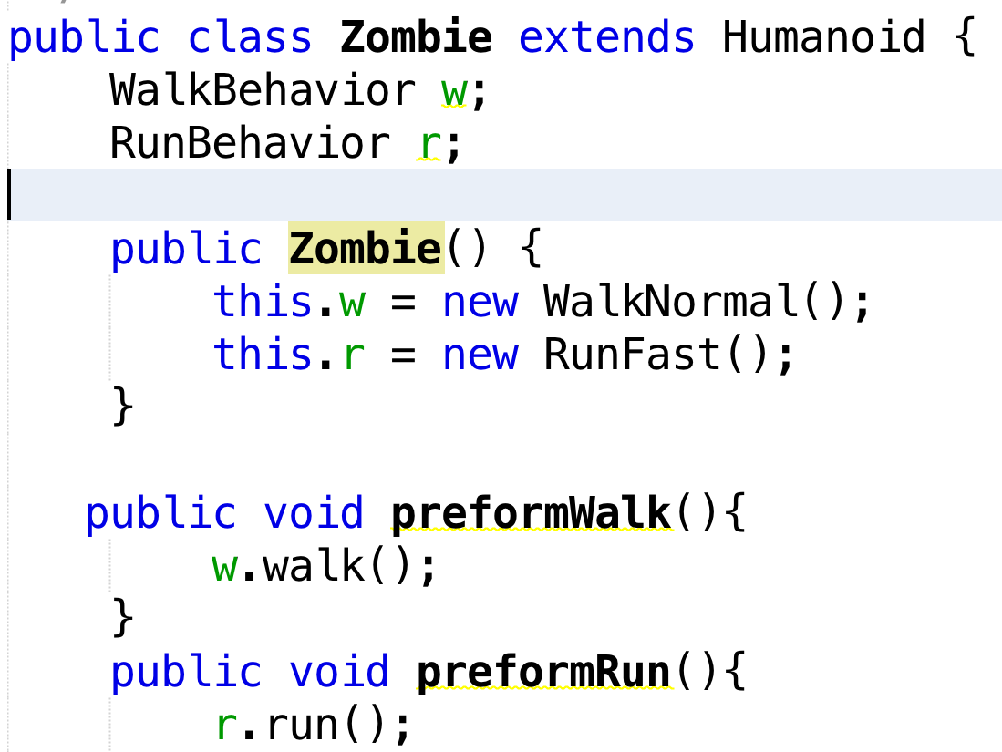
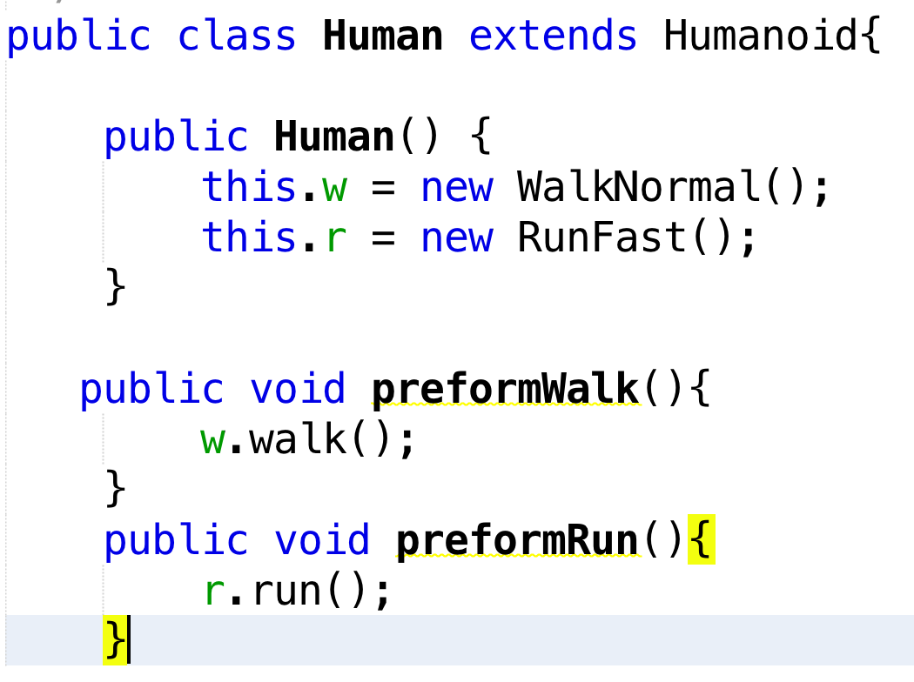
Sub classes

Slide 71
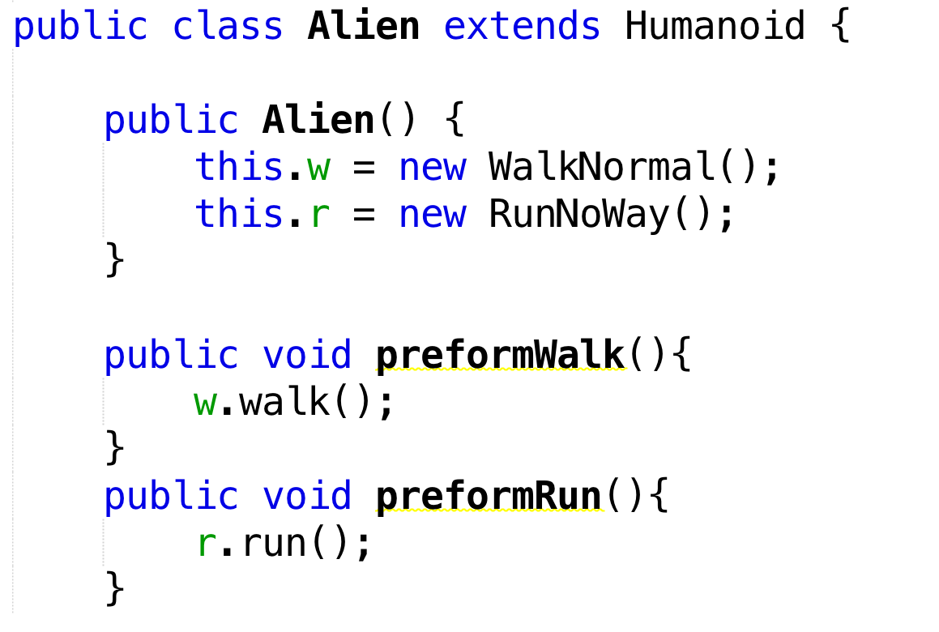
Sub classes

Slide 72
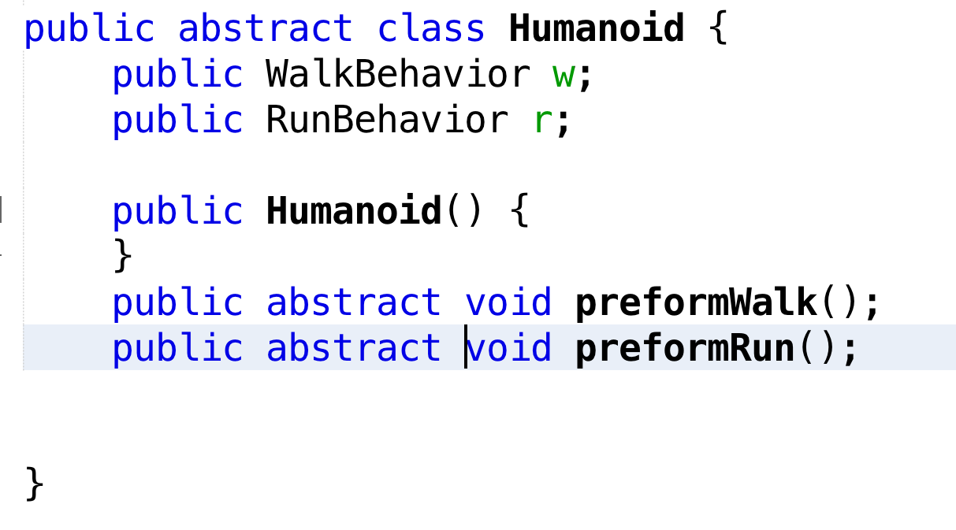
Humanoid Superclass

Slide 73
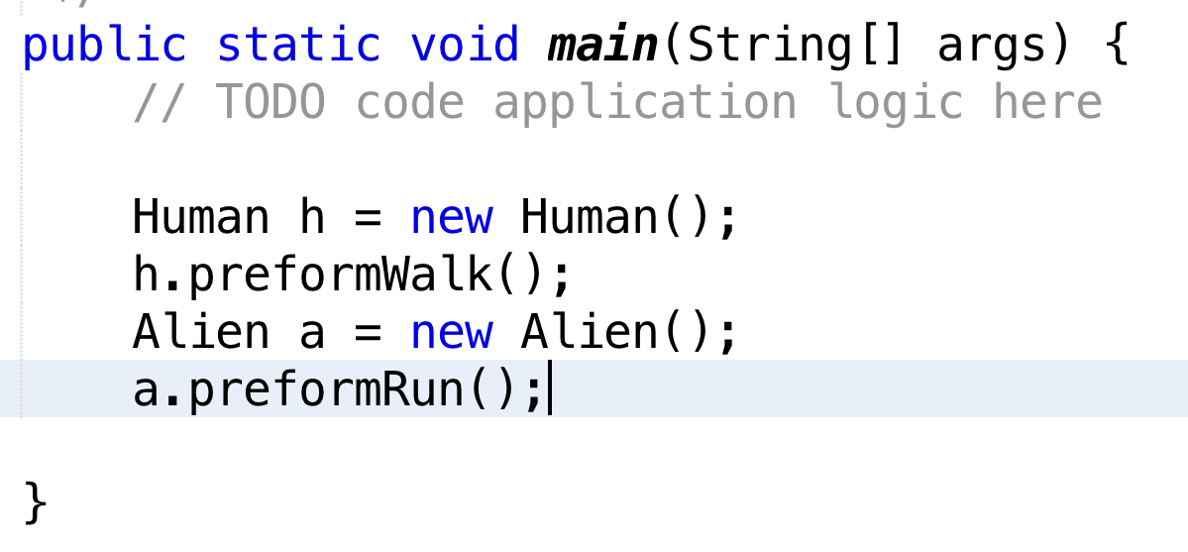
Main

Slide 74
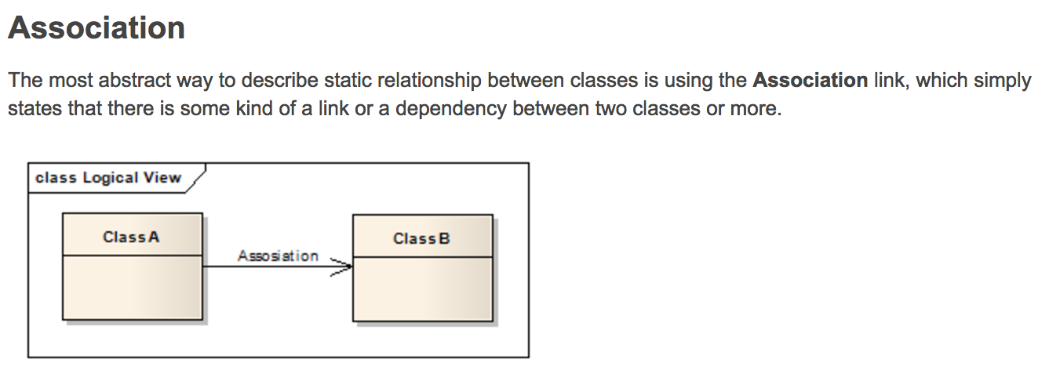
Association, Aggregation and Composition
http://aviadezra.blogspot.ca/2009/05/uml-association-aggregation-composition.html

Slide 75
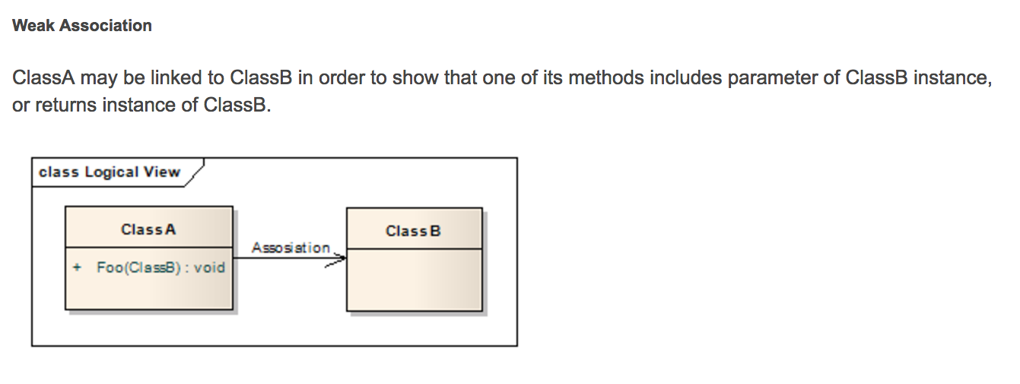
Weak Association

Slide 76
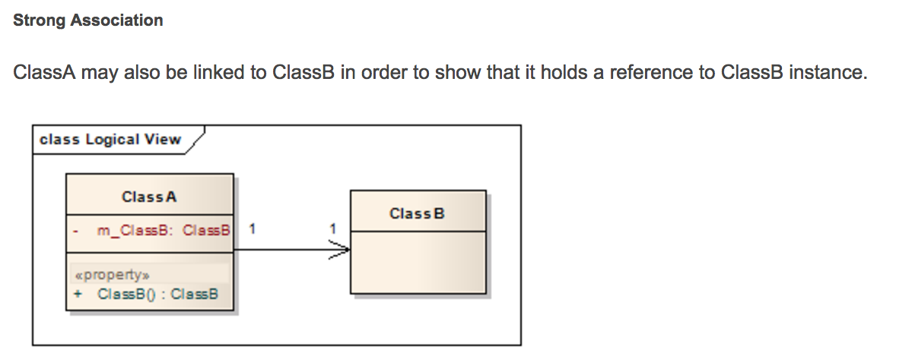
Strong Association

Slide 77
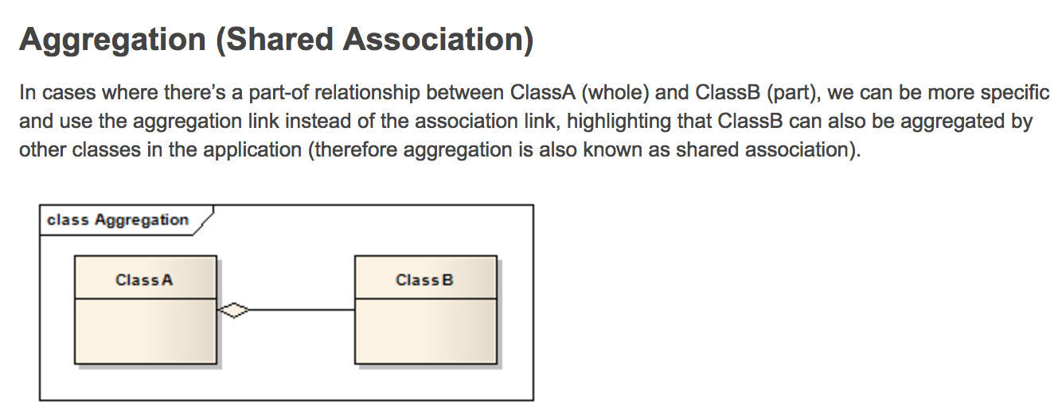
Aggregation

Slide 78
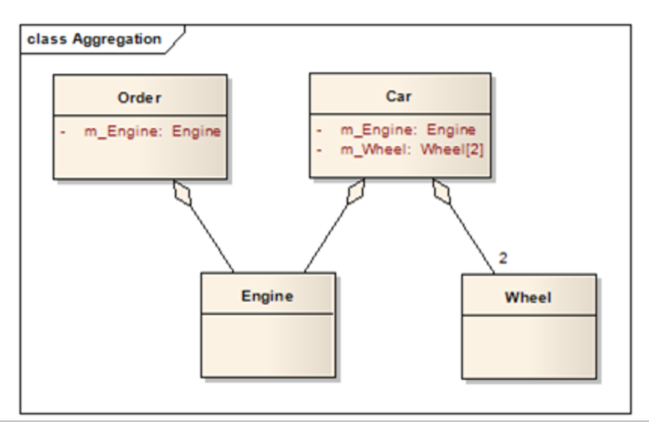
Aggregation is not exclusive

Slide 79
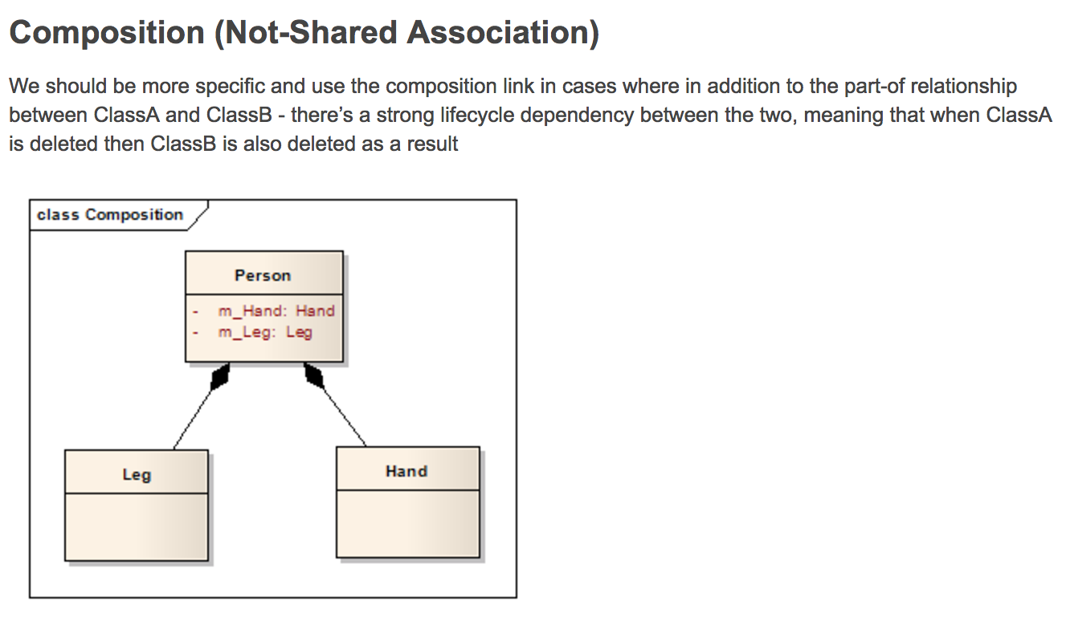
Composition (Non-shared Aggregation)

Slide 80
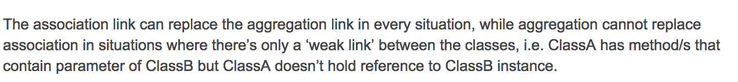
Association vs. Aggregation (or plain arrow vs diamond)
When drawing UML, if there is an aggregation it is correct to use an plain arrow or a diamond

Slide 81
Plain arrow (Association)
Can mean:
One class returns an instance of the other class
One class has an instance of the other class as a parameter
One class has the other class as a data member (exclusive)
One class has the other class as a data member (non-excluive)

Slide 82
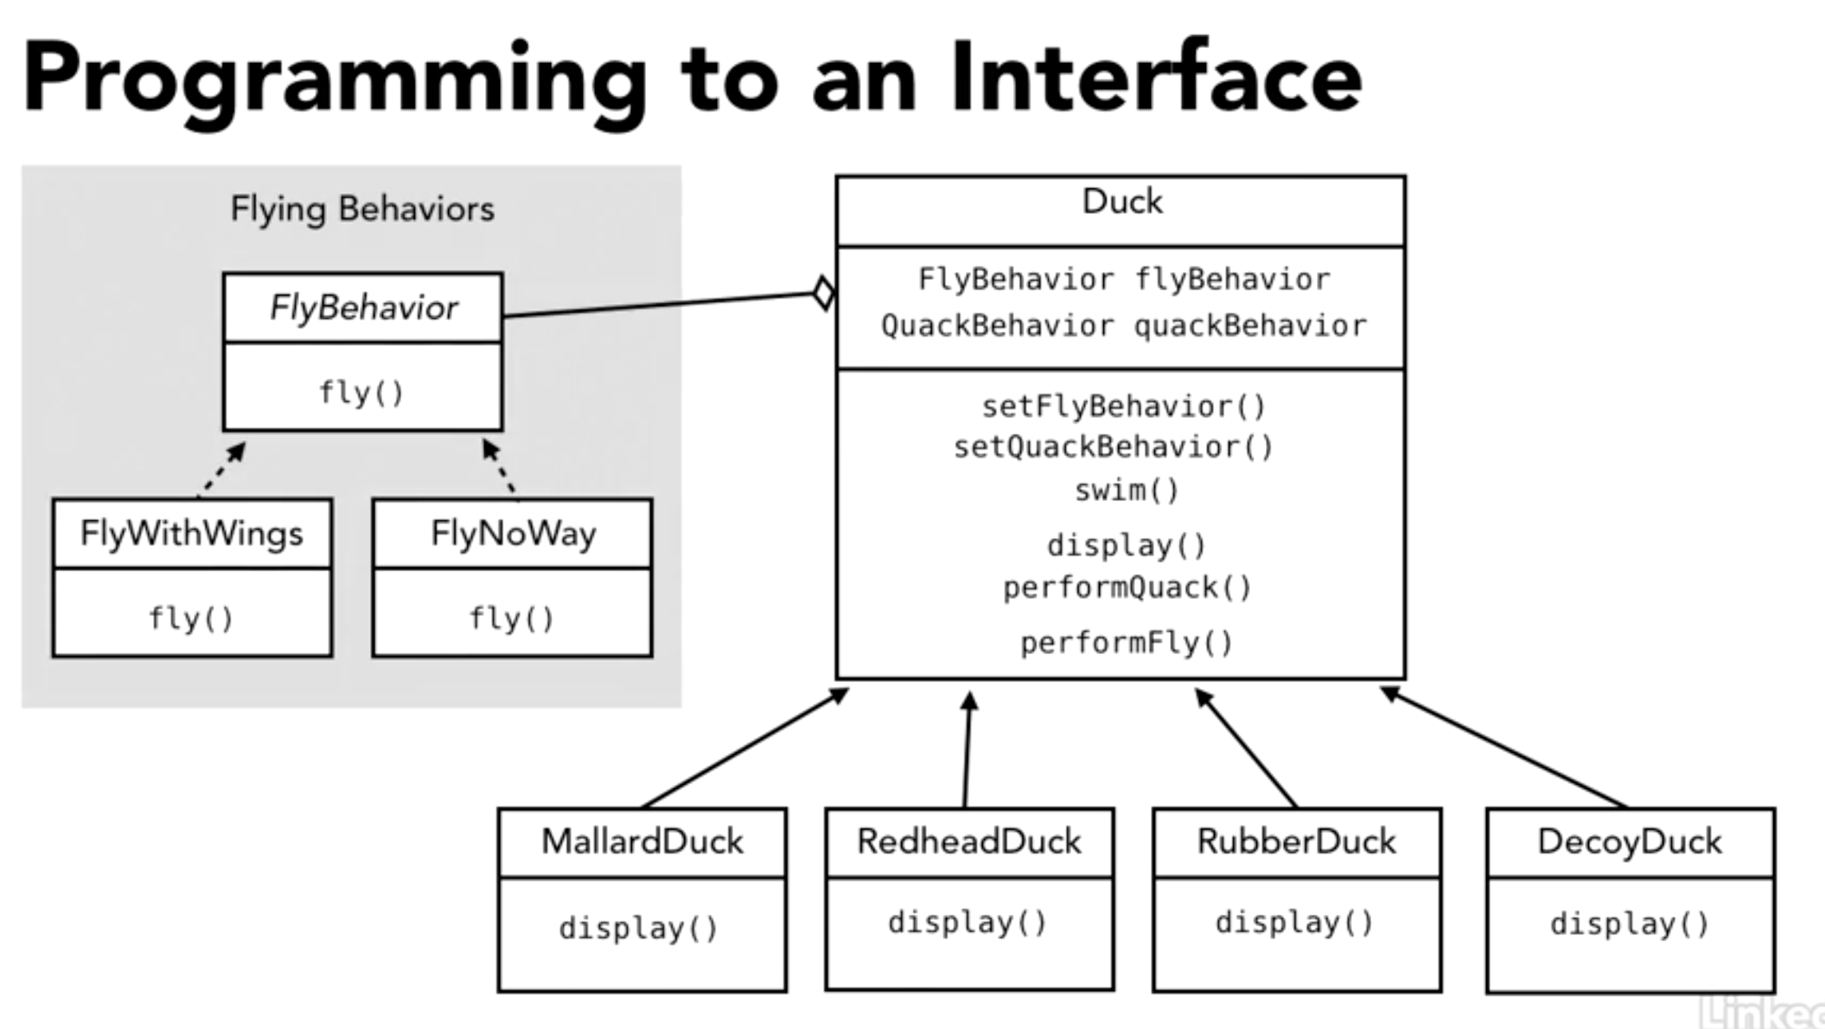
Examples

Slide 83
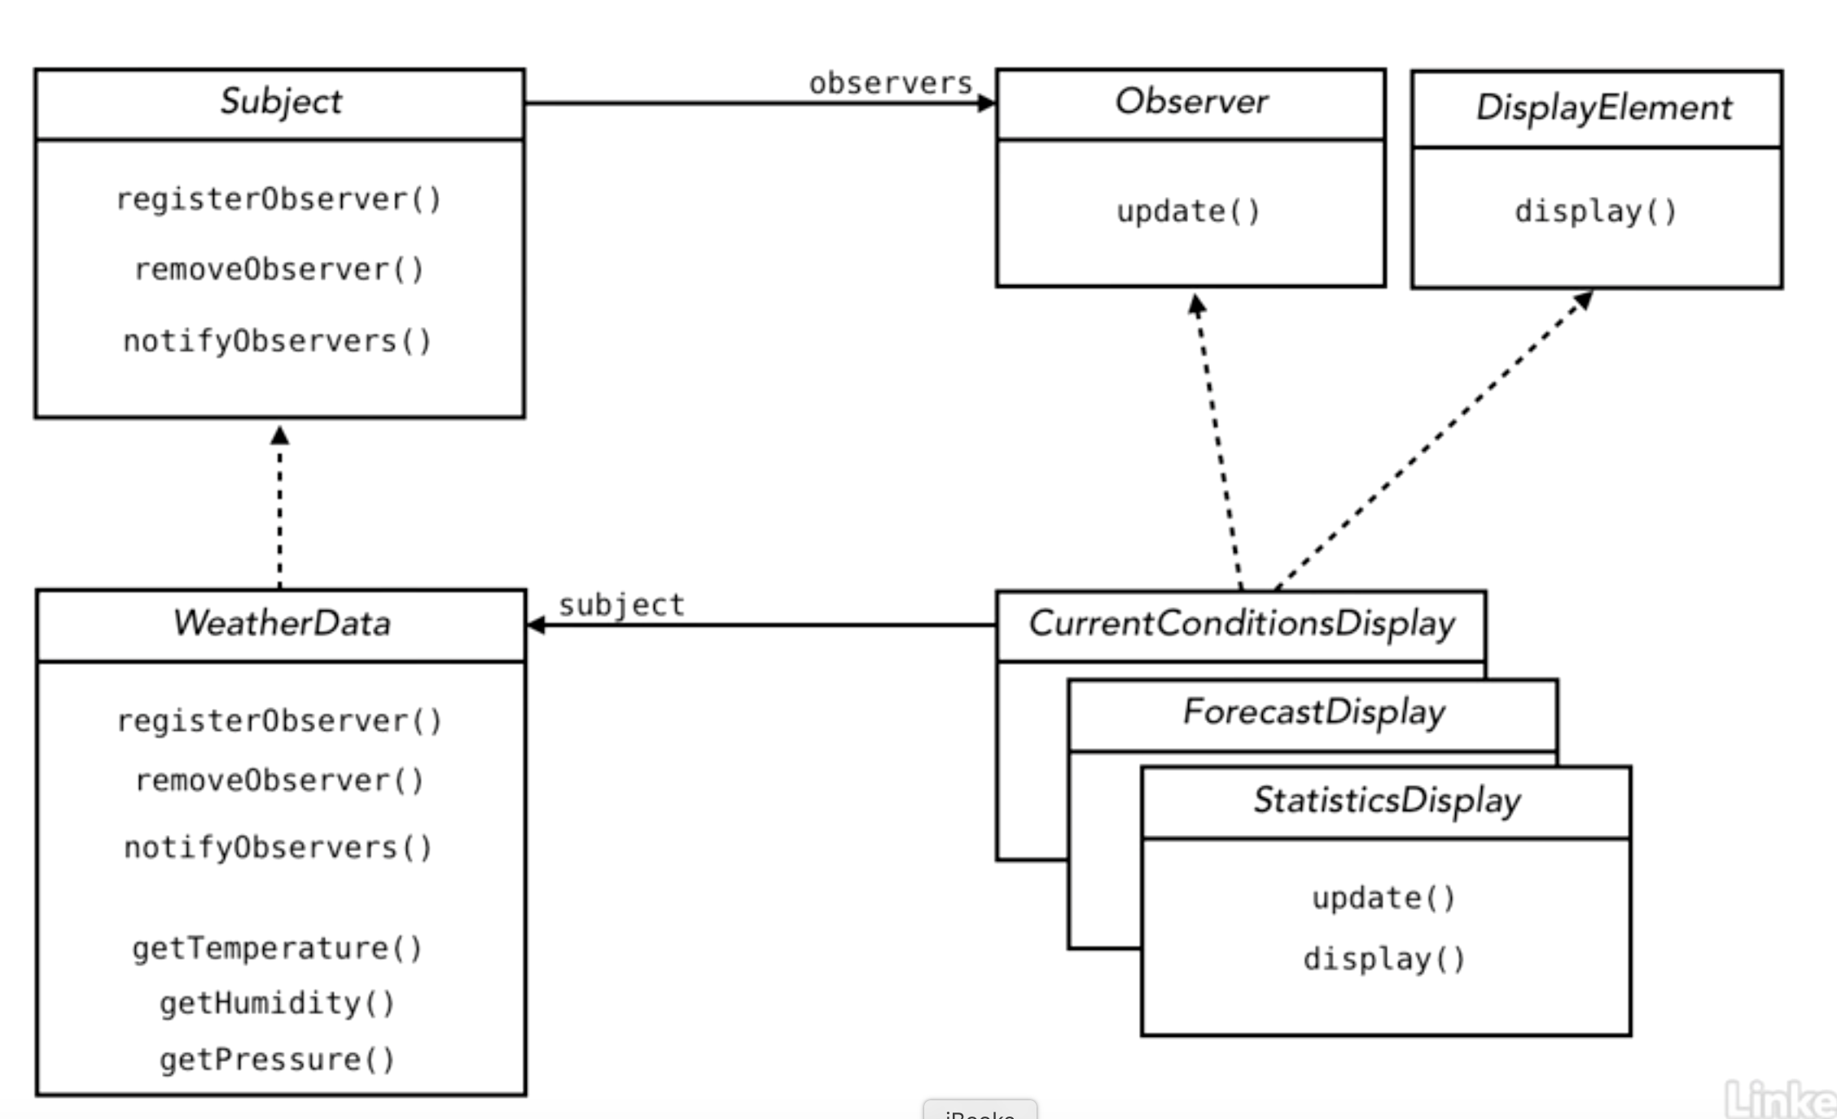
Example

Slide 84
Design Patterns
https://www.lynda.com/Developer-Programming-Foundations-tutorials/Foundations-Programming-Design-Patterns/135365-2.html

